Slide 1
NATIONAL DEVELOPMENT
Reforming Vietnam's Political System
Necessity, Current Progress, and Our Responsibilities

Slide 2
01
The Necessity of Reform
Adapting governance to modern economic demands

Slide 3



Why Reform is Imperative
Economic Transition
Bureaucratic Efficiency
Global Integration
Meeting global transparency standards.
Adapting to socialist-oriented market demands.
Eradicating red tape and delays.

Slide 4
02
Current Process & Real Examples
Transforming institutional structures today

Slide 5
The 2025 Administrative Restructuring
1
2
3
Provincial Merger
Abolishing Districts
Grassroots Empowerment
63 provinces consolidated to 34.
Two-tier province-commune model.
Expanded commune-level autonomy.

Slide 6

ANTI-CORRUPTION REFORM
The "Blazing Furnace" Campaign
Shift from reactive punishment to proactive institutional design.
Strict mandatory asset declarations.
Transparent public procurement systems.
Public sector salary reforms.

Slide 7
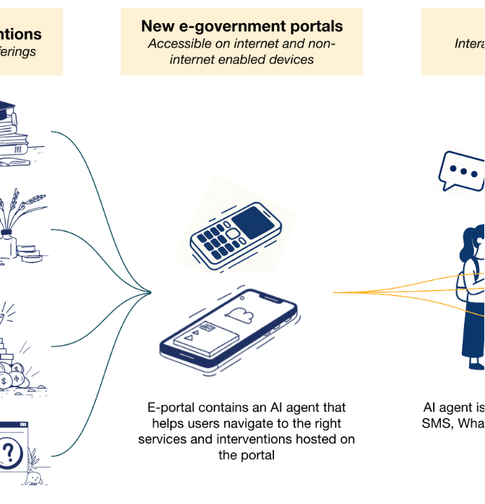

Digital Transformation
Public Administrative Centres utilizing digital signatures.

Slide 8
03
Responsibilities of Our Group
The role of youth in national development

Slide 9






Student Action Plan
Academic Focus
Civic Duty
Integrity
Mastering state policy frameworks.
Leading grassroots democratic activities.
Cultivating strong moral principles.

Slide 10
The Ultimate Goal
2045
Vietnam's vision to become a high-income developed nation.

Slide 11
Discussion & Questions
Let's explore the practical impacts of these reforms together.

Slide 12


Image Sources
https://www.realclimate.org/images//rahmstorf_holiday_fire-600x450.webp
Source: www.realclimate.org
https://www.cgdev.org/sites/default/files/2025-05/GenerativeAIfigure.png
Source: www.cgdev.org

